Slide 1
MEASUREMENT USING CRO

Slide 2
Measurement using CRO and DSO: Measurement of voltage, current, frequency.Using CRO : Lissajous pattern method, broken ring pattern method
Oscilloscope probes and active probes
Using CRO : Modulated ring pattern method, phase angle measurement-direct method, X-Y method

Slide 3
Measurement of Voltage
Cathode Ray Oscilloscope (CRO) is primarily a voltage-measuring instrument. Once we have measured the voltage, other quantities can be calculated.
CRO is a voltage dependent instrument and can be used for the measurement of voltages at any frequency within the range of the operation of the CRO. Fig. 7.23. shows the display of voltage

Slide 5
To measure the voltages
1. The input voltage is applied on the vertical deflection plates
2. An appropriate sweep is applied to the horizontal plates.
3. The amplitude attenuator is then adjusted such that the signal is displayed comfortably on the screen.
4. The amplitude trace of the waveform is then observed on the screen.
5. The position of the attenuator knob gives the volts/cm position or volts/ division.
6. The peak to peak voltage of the input signal is measured by multiplying this position value with the number of centimeters the signal is occupying in the vertical direction.

Slide 6
7. The peak to peak voltage of the signal is given by

Slide 10
Measurement of Current
Current cannot be measured directly with a CRO. To measure the current, a known resistance is taken and the potential drop across the resistance is determined with the help of measurement of potential at both ends of the resistor. The voltage across resistance is displayed on CRO and measured as shown in Fig. 7.26.
The voltage divided by the considered resistance value gives the amount of current flowing in the device.

Slide 12
Measurement of Time period
The waveform is displayed on the screen such that one complete cycle is visible on the screen.
Note the time/division on the front panel. Then the period of the waveform can be obtained as,

Slide 14
Lissajous figure
Lissajous figure is the pattern which is displayed on the screen, when sinusoidal signals are applied to both horizontal & vertical deflection plates of CRO.
These patterns will vary based on the amplitudes, frequencies and phase differences of the sinusoidal signals, which are applied to both horizontal & vertical deflection plates of CRO.
The following figure shows an example of Lissajous figure

Slide 15
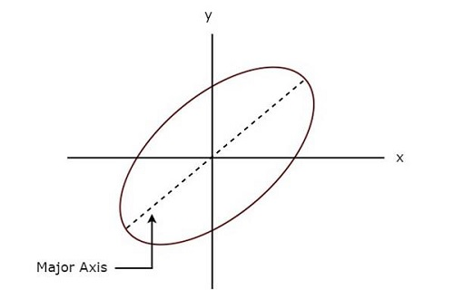
The above Lissajous figure is in elliptical shape and its major axis has some inclination angle with positive x-axis.

Slide 16
Lissajous Figures
Lissajous Figures (or patterns) are named in honour of the French scientist who first obtained them geometrically and optically. They illustrate one of the earliest uses to which the CRO was put.
Lissajous patterns are formed when two sine waves are applied simultaneously to the vertical and horizontal deflecting plates of a CRO.
The two sine waves may be obtained from two audio oscillators as shown in Fig. 7.28. Obviously, in this case, a sine wave sweeps a sine-wave input signal.
The shape of the Lissajous pattern depends on the frequency and phase relationship of the two sine waves.

Slide 18
Two sine waves of the same frequency and amplitude may produce a straight line, an ellipse or a circle depending on their phase difference as shown in Fig. 7.29.
In general, the shape of Lissajous Figures depends on
(i) Amplitude
(ii) Phase difference
(iii) Ratio of frequency of the two waves.
Consider the two signals applied having same amplitude and frequency with phase difference of Ø between them,

Slide 20
Straight Line
1. The straight line is formed when the two voltages are in phase with each other or 180° out of phase with each other.
2. The straight line formed angle 45° with horizontal when the magnitude of voltages are equal.
3. An increase in vertical deflection voltage causes the line to have an angle greater than 45°with the horizontal.
4. A grater horizontal voltage makes the angle less than 45 ° with the horizontal
Circle
When the magnitudes of two voltages are equal and the phase difference between them is either 90° or 270°
Ellipse
The ellipse is formed when voltage are not equal and or out of phase.

Slide 21
Uses of Lissajous Figures
Lissajous Figures is used as:
(i) determining an unknown frequency by comparing it with a known frequency
(ii) checking audio oscillator with a known-frequency signal
(iii) checking audio amplifiers and feedback networks for phase shift.

Slide 22
Measurements using Lissajous Figures
We can do the following two measurements from a Lissajous figure.
Frequency of the sinusoidal signal
Phase difference between two sinusoidal signals
Now, let us discuss about these two measurements one by one.

Slide 23
Frequency Determination with Lissajous Figures
Lissajous figure will be displayed on the screen, when the sinusoidal signals are applied to both horizontal & vertical deflection plates of CRO. Hence, apply the sinusoidal signal, which has standard known frequency to the horizontal deflection plates of CRO. Similarly, apply the sinusoidal signal, whose frequency is unknown to the vertical deflection plates of CRO

Slide 24
Frequency Determination with Lissajous Figures
The unknown signal is applied across one set of deflecting plates and a known signal across the other. By studying the resultant Lissajous pattern, unknown frequency can be found.
Depending on the frequency ratio, the various patterns obtained are shown in Fig. 7.30. The ratio of the two frequencies is given by
In Fig. 7.30 (a), there is one point of tangency along the horizontal as well as vertical axis. Hence, fH = fV i.e. the signals have the same frequency

Slide 26
The ratio of frequencies when open ended Lissajous patterns are obtained can also be found by treating the open ends as half tangencies as shown in Fig. 7.31.

Slide 27
It should be noted that this method of frequency determination has limitations and is being discarded gradually because low-cost digital frequency counters are available in the market.
The two main limitations of this method are as under:
(i) the numerator and denominator of the frequency ratio must be whole numbers,
(ii) the maximum ratio of frequencies that can be used is 10 : 1. Beyond that, the Lissajous patterns become too complex to analyse.

Slide 30
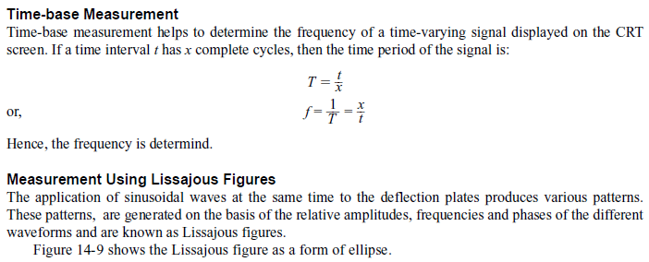
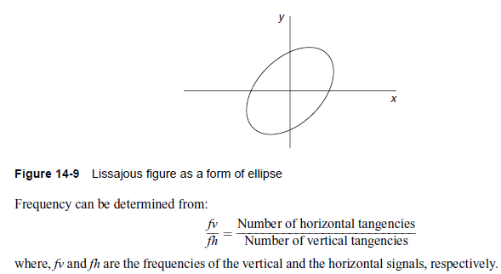
MEASUREMENTS USING THE CATHODE-RAY OSCILLOSCOPE:
1) Measurement of Frequency:

Slide 31
Phase Determination with Lissajous Figures
A Lissajous pattern is obtained on CRO with an unknown phase difference f. This pattern which is in the form of an ellipse, provides a simple means of finding phase difference between two voltages.
The gains of the vertical amplifiers are adjusted so that the ellipse fits exactly into a square marked by the lines on the graticule.

Slide 32
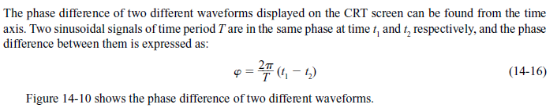
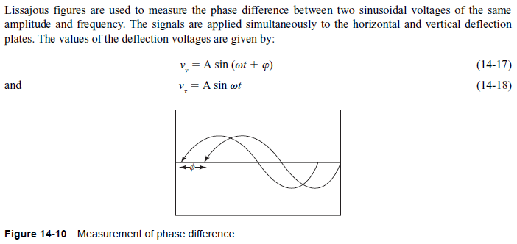
MEASUREMENTS USING THE CATHODE-RAY OSCILLOSCOPE:
2) Measurement of Phase:
3 Measurement of Phase Using Lissajous Figures:

Slide 33

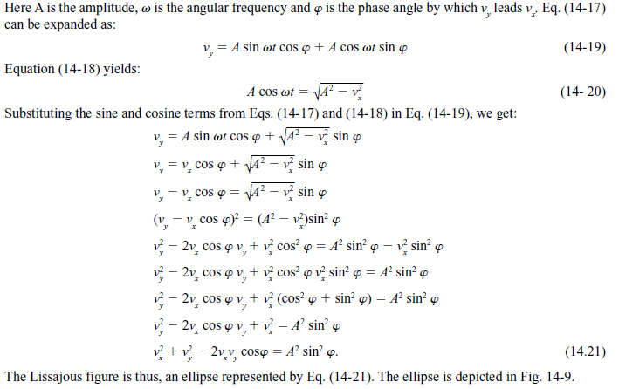
Measurement of Phase Using Lissajous Figures:

Slide 34
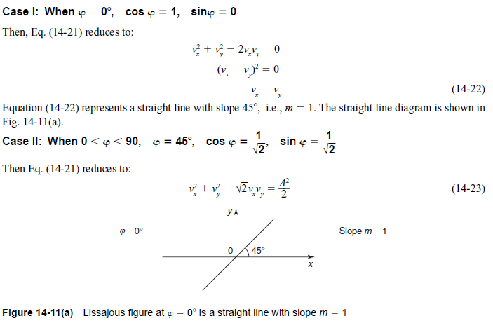
Measurement of Phase Using Lissajous Figures:

Slide 35
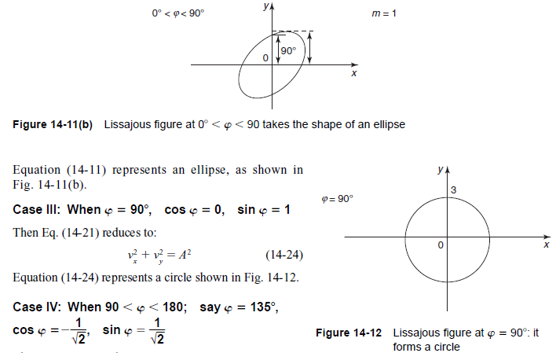
Measurement of Phase Using Lissajous Figures:

Slide 36
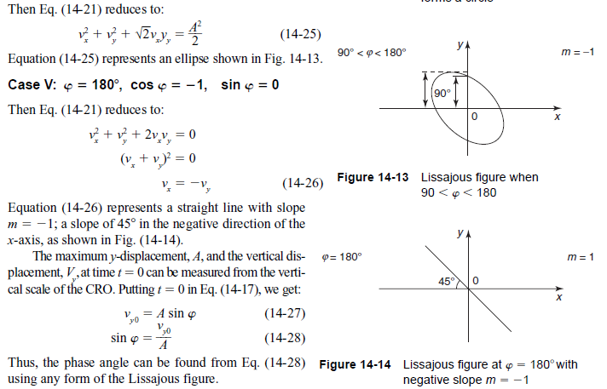
Measurement of Phase Using Lissajous Figures:

Slide 37
If the major axis lies in first and third quadrants
If the major axis of the ellipse lies on the first and third quadrants, its slope is positive as shown is Fig. 7.33. Then the phase angle is either between 0° and 90° or between 270° and 360°.The sine of the phase angle between the voltages is given by

Slide 38
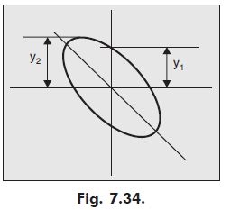
If the major axis in lies in second and forth quadrants
If the major axis of the ellipse lies on the second and forth quadrants, its slope is negative as shown in Fig. 7.34. Then the phase angle is either between 90° and 180° or between 180° and 270°. The sine of the phase angle between the voltages is given by

Slide 39
Example 7.9. The Lissajous Figure obtained on the CRO is shown in Fig. 7.35. Find the phase difference between the two waves applied.
Solution.
From the Lissajous Figure shown in Fig 7.35, we know that

Slide 45
Spot Wheel Method of Display
CRO is not a precision instrument for measuring frequency of an alternating voltage because the accuracy depends directly on the accuracy of calibrated scale of variable frequency source, which is usually a few per cent. It is used for rough estimate of frequency or when voltage waveform is so complex that a frequency counter not operates reliably.
Lissajous pattern method becomes more and more complicated with the increase in the ratio of the two frequencies. In such cases, spot wheel method of display is used. Refer to Fig. 7.36.

Slide 47
In this method, an intensity modulated circular or elliptical display is produced on the CRT screen. The lesser of the two frequencies under comparison is applied to the CRT deflection plates through the resistance capacitance (R-C) phase shifter as shown in Fig. 7.36 and the higher frequency is applied to the control grid of the CRT as shown in Fig. 7.37.
Consequently, the pattern appears as a series of alternate bright and dark spots as shown in Fig. 7.38, where the ratio of the high to low frequencies is given by the number of bright spots. In Fig 7.38, the frequency is 20:1 as there are 20 blank pattern.

Slide 48
If two sinusoidal signals are equal in magnitude but 90° out of phase are applied to the vertical and horizontal deflecting plates, a circle is formed.
In a case if single sinusoidal signal is applied to a phase shifting circuit, it is possible to have two outputs, equal in magnitude and 90° out of phase.
If the voltages across resistor R and capacitor C are equal then the pattern obtained is a circle. When the applied voltages are unequal, the
pattern obtained is an elliptical.

Slide 49
Problem
Show the approximate pattern obtained when the standard signal frequency is 300 Hz and modulating(Unknown signal) frequency is 900 Hz

Slide 50
Gear Wheel Method
In the Lissajous pattern large numbers of loop makes their counting difficult. Fig. 7.39 shows a test method that makes use of a modulated ring pattern in place of looped figure and allows a higher count. This pattern is known as a gear wheel or toothed wheel.
By multiplying the known frequency by the number of teeth in the pattern we determine the unknown frequency

Slide 51
Circuit diagram is shown in Fig. 7.40. A phase shift of 90° between the horizontal and vertical channels of the oscilloscope, required to give a ring or circle pattern with the known frequency fv, is introduced by R-C phase shift network.
A voltage from unknown frequency modulates the ring. With the equal voltage across R and C circle pattern will be obtained, while with unequal voltages it will be an ellipse pattern.
To avoid distortion the unknown frequency must be large than known frequency and the amplitude of the known frequency must be smaller than that of unknown frequency

Slide 53
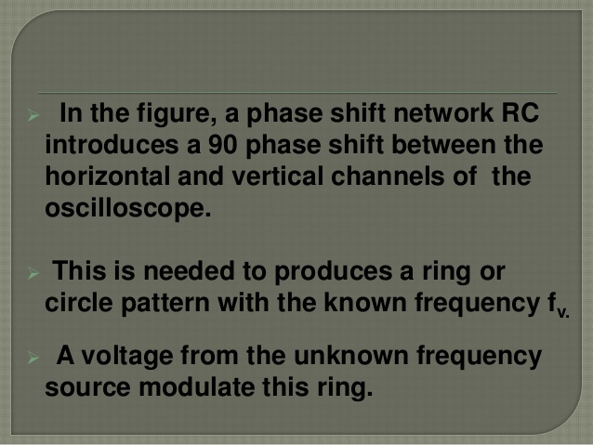

Slide 54
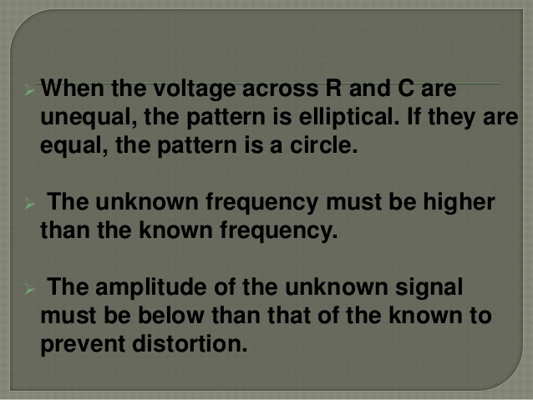

Slide 55
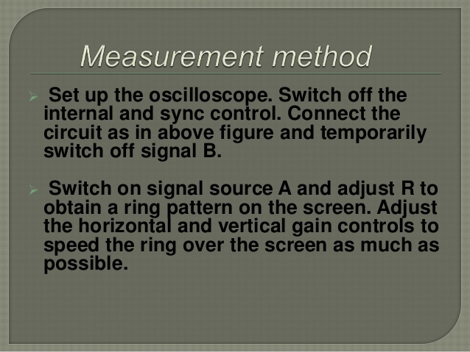

Slide 56
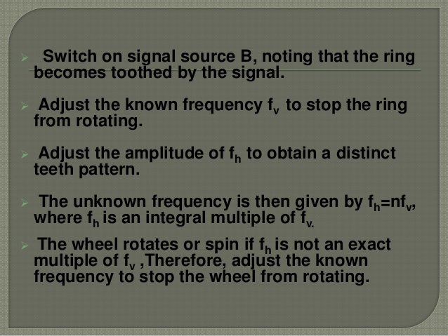

Slide 57
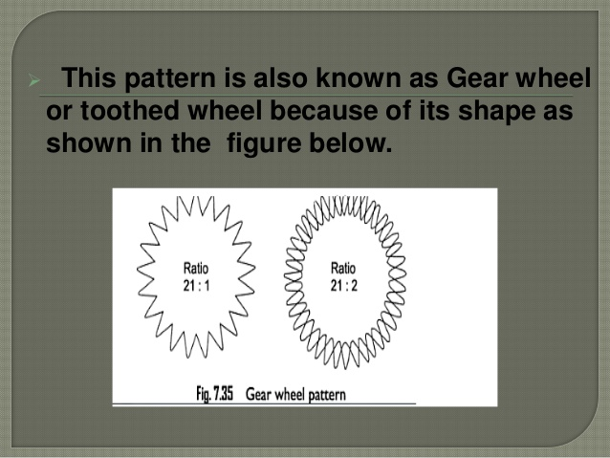

Slide 58
Problem
1. Show the approximate pattern obtained when the standard signal frequency is 200 Hz and modulating(Unknown signal) frequency is 800 Hz.
2. A Lissajous pattern is obtained on a CRO screen when sinusoidal voltages are applied to the two sets of deflecting plates. The Figure makes 3 tangencies with the horizontal and 5 tangencies with the vertical. If the frequency of the horizontal signal is 2 kHz, find the frequency of the vertical signal.

Slide 59
TYPES OF THE CATHODE-RAY OSCILLOSCOPES:
The categorization of CROs is done on the basis of whether they are digital or analog. Digital CROs can be further classified as storage oscilloscopes.
1. Analog CRO: In an analog CRO, the amplitude, phase and frequency are measured from the displayed waveform, through direct manual reading.
2. Digital CRO: A digital CRO offers digital read-out of signal information, i.e., the time, voltage or frequency along with signal display. It consists of an electronic counter along with the main body of the CRO.
3. Storage CRO: A storage CRO retains the display up to a substantial amount of time after the first trace has appeared on the screen. The storage CRO is also useful for the display of waveforms of low-frequency signals.
4. Dual-Beam CRO: In the dual-beam CRO two electron beams fall on a single CRT. The dual-gun CRT generates two different beams.
These two beams produce two spots of light on the CRT screen which make the simultaneous observation of two different signal waveforms possible. The comparison of input and its corresponding output becomes easier using the dual-beam CRO.

Slide 60
Oscilloscope Probes
A probe is a conductor used to establish a connection between the circuit under test and the measuring instrument. While connecting the test circuit, the probe does not alter, load or disturbs the circuit and signal conditions to be analysed.
The probe should have high impedance. The probe bandwidth should be as high as possible. It should be about 10 times the bandwidth of the oscilloscope. The ideal probe offers the following key attributes:
(a) Ease of connection
(b) Absolute signal fidelity
(c) Zero signal source loading
(d) Complete noise immunity

Slide 61
General diagram of probe is shown in Fig. 7.43.
The probe tip is the signal sensing circuit. It may be passive or active. It consists of the resistors and capacitors if passive and in active it consists of active components like FET source follower circuit.

Slide 62
Fig. 7.44 shows a 60 MHz bandwidth oscilloscope probe x1/x10. A two position slide switch allows attenuation of either × 1 or × 10 to be selected.
The probe cable is a special coaxial type (with a resistive center conductor to damp out ringing), with quite-effective shielding. Its capacitance is greater than that of an open wire, and in some cases, such a probe is satisfactory. The probes are of many types, they are given below:
1. Direct probe
2. Isolation Probe
3.High impedance or 10: 1 Probe
4. Active Probes
5. Current Probe
6. Differential Probes

Slide 63
Direct Probe 1:1
The simplest types of probe are the test lead. Test leads are simply convenient lengths of wire for connecting the CRO input to the point of observation.
At the end of CRO, they usually terminate with lugs, banana tips or other tips to fit input jacks of the scope, and at the other end has a crocodile clip or any other convenient means for connection to the electronic circuit.
The CRO has high input impedance and high sensitivity. So the test leads should be shielded to avoid hum pickup, unless the scope is connected to low impedance high level circuits

Slide 64
Direct probe is shown in Fig. 7.45. While using the shielded probe, the shunt capacitance of the probe and cable is added to the input impedance and capacitance of the oscilloscope and acts to lower response of the oscilloscope to high impedance and high frequency circuits.

Slide 65
Isolation Probe
The input capacitance of the scope and the stray capacitance of the test lead are very high. It causes the sensitive circuit to break into oscillation when CRO is connected.
This effect can be prevented by an isolation probe. The isolation probe is made by placing a carbon resistor in series with test lead as shown in Fig. 7.46.
An isolation probe is employed to avoid the undesirable circuit loading effect of the shielded probe.
This probe causes a slight change in the amplitude of the waveform and a slight change in the wave shape.
To avoid this possibility, a high impedance compensated probe, called a low capacitance probe or a 10:1 probe is used.

Slide 66
High Impedance or 10: 1 Probe
This probe is also known as passive voltage probe. The basic function of this probe is to increase the input impedance and reduce the effective input capacitance of an oscilloscope.
This probe head uses a resistor and a capacitor combination. The resistance R1 is shunted by an adjustable capacitor C1. This capacitor is called compensating capacitor.
A co-axial cable connects the probe head to the CRO input as shown in Fig. 7.47. Let C2 be the probe cable equivalent capacitance. The input resistance and capacitance of CRO can be referred to as Rin and Cin. The typical values of Rin and C in are 1 MW and 20 pF.

Slide 70
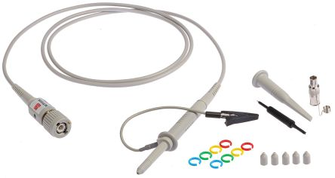

Slide 71
Active Probe
The active probes are used for connecting fast rising and high frequency signals. These probes are very useful for small signal measurements as their attenuation factor is very small. The block diagram of the active probe is shown in Fig. 7.50. As seen from this figure, the active probe consists of an active element like FET source follower circuit and BJT emitter follower circuit along with a co-axial cable termination.

Slide 72
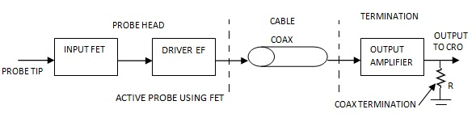

Slide 73
FET is used as an active element to amplify the signal. The voltage gain of FET source follower is unity but it provides a power gain due to which input impedance increases. The output impedance of FET source follower is very low and hence eliminates the loading effect.
Instead of connecting cable directly to CRO from FET stage, one more stage of BJT emitter follower is introduced as shown in Fig. 7.51. This emitter follower drives the cable and helps further in solving the problems of improper impedance matching.

Slide 74
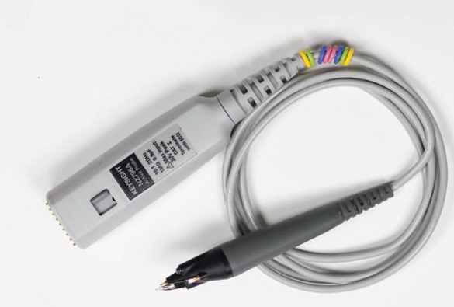

Slide 75
These probes are more expensive and bulky than passive probes, but they are useful for small signal measurements, because their attenuation is less.
Active probes have limited use because the FET probe effectively becomes an attenuator probe. So the oscilloscopes are typically used with 10:1 attenuator probe.

Slide 76
Current Probe
This probe provides a method of inductively coupling the signal to the CRO input. The direct electrical connection between the test circuit and CRO is not necessary.
This probe can be clamped around a wire carrying an electrical current without any physical contact to the probe.
Thus the magnitude of current with a frequency range from d.c to 50 MHz can be measured using this probe.
The current sensor consists of two parts: A conventional transformer for transforming alternating current to voltage, and a Hall effect device for converting direct current to a voltage.

Slide 77
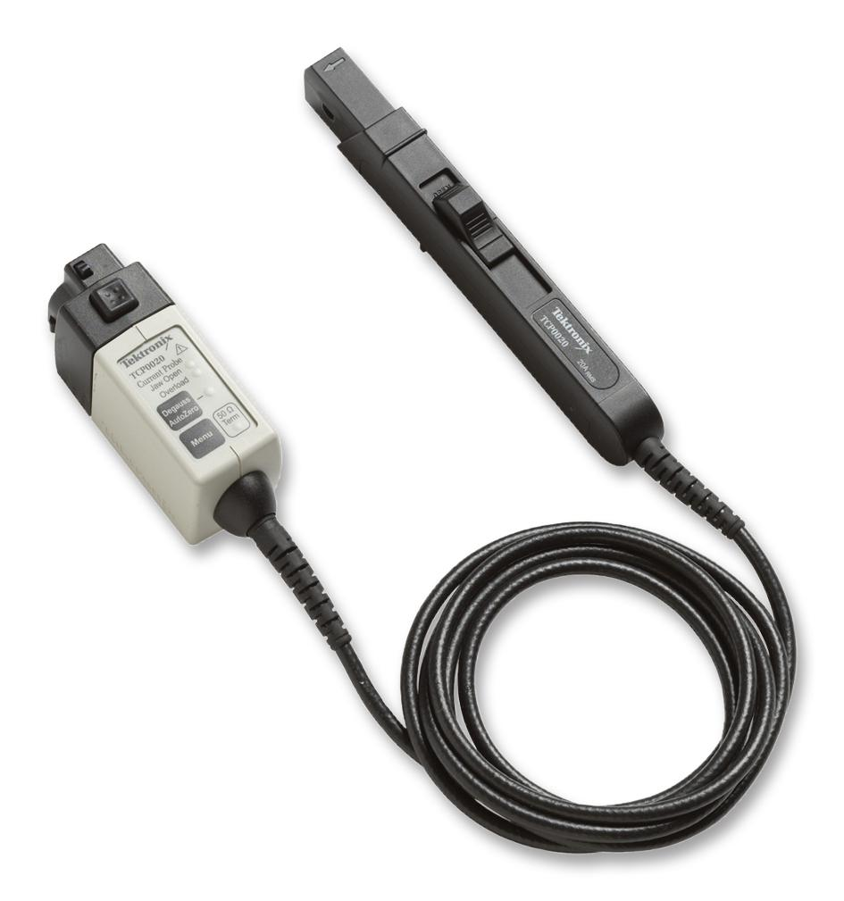

Slide 78
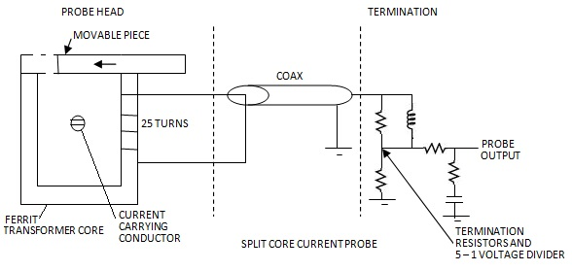

Slide 79
The split core passive probe can be clipped around a conductor whose current is to be measured. The current transformer is the sensing device in this probe.
It consists of a stationary U-piece and a movable flat piece. A coil of several turns (around 25 turns) is wound on the leg of the ferrite core that forms the secondary of the transformer. The single turn primary is the conductor under test.
Due to the flow of current through the conductor under test a voltage will be produced at the secondary of the current transformer. This output is coupled through a coaxial cable to the input of the CRO, through the termination. The termination circuit can be passive or active that provides the characteristic impedance of the cable. The current probe can sense changes in current only. Hence it is useful only to measure a.c signals. The probe sensitivity may be around 10 mA/mV.

Slide 80
The current probe is shown in Fig. 7.52. A magnetic core with a removable piece is used as the coupling element for the current probe.
The wire carrying the current to be measured is inserted in the center of the magnetic core and acts as a primary of a transformer.
The core is the ferrite U shaped and work as secondary of the transformer. Because of the electromagnetic induction principle, whenever current flows through primary, the e.m.f gets induced in the secondary.
This is fed to the CRO input via termination circuitry

Slide 81
When d.c current flows through the wire, it will not appear at the secondary. In addition to this flux in core may increase causing the saturation of the core which is undesirable.
This provides inaccurate measurements.
To avoid this problem Hall Effect sensor and a feedback amplifier is added to the probe.

Slide 82
Differential Probes
This is a type of active probe shown in Fig. 7.53. It has two inputs, positive and negative. It has a separate ground lead and it drives single terminated 50 W cable to transmit its output to one oscilloscope channel.
This output voltage signal is proportional to the difference between the voltages appearing to the input terminals.
There is a restriction that the two input signals must be within a few volts from ground so that signals can stay within the dynamic range of the probe.

Slide 83
The output is proportional to the difference between the two inputs and hence the name, differential probe. It rejects the common mode signal but still some error voltage results proportional to common mode signals like noise.
The common mode rejection power can be measured by connecting both the input simultaneously to the same input. The rejection is best for d.c and at low frequencies.
But at high frequencies the rejection is poor.
Such probes can handle the signals which are typically less than a few volts only. The peaks above certain amplitude will be clipped in such probes.
This probe is bulky, expensive, having less dynamic range and requires external power supply.

Slide 85
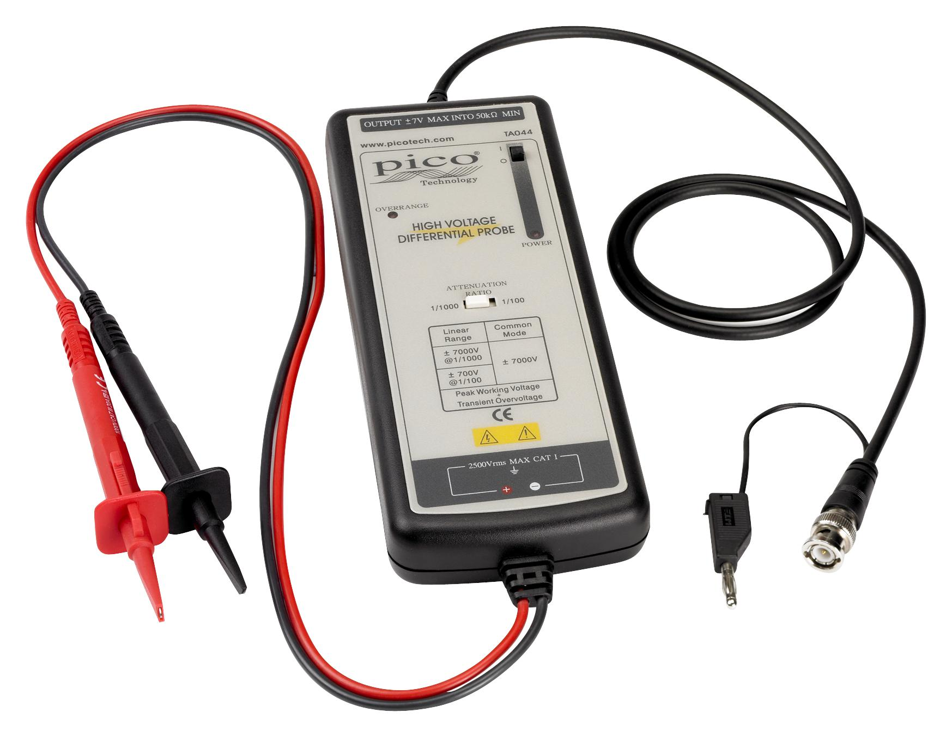

Slide 86
Oscilloscope Specifications and Performance
The oscilloscope specifications are necessary when choosing a particular oscilloscope for a particular application.
It is necessary to look in detail at the specifications list to see whether the instrument meets its requirements.
The oscilloscope specifications and performance are given below:
1. Bandwidth. The bandwidth specification tells you the frequency range the oscilloscope accurately measures. As signal frequency increases, the capability of the oscilloscope to accurately respond decreases. By convention, the bandwidth tells you the frequency at which the displayed signal reduces to 70.7% of the applied sine wave signal. (This 70.7% point is referred to as the “–3 dB point,” a term based on a logarithmic scale.)

Slide 87
2. Rise Time. Rise time is another way of describing the useful frequency range of an oscilloscope. Rise time may be a more appropriate performance consideration when you expect to measure pulses and steps. An oscilloscope cannot accurately display pulses with rise times faster than the specified rise time of the oscilloscope.
3. Vertical Sensitivity. The vertical sensitivity indicates how much the vertical amplifier can amplify a weak signal. Vertical sensitivity is usually given in millivolts (mV) per division. The smallest voltage a general purpose oscilloscope can detect is typically about 2 mV per vertical screen division.
4. Sweep Speed. For analog oscilloscopes, this specification indicates how fast the trace can sweep across the screen, allowing you to see fine details. The fastest sweep speed of an oscilloscope is usually given in nanoseconds/div.

Slide 88
5. Gain Accuracy. The gain accuracy indicates how accurately the vertical system attenuates or amplifies a signal. This is usually listed as a percentage error.
6. Time Base or Horizontal Accuracy. The time base or horizontal accuracy indicates how accurately the horizontal system displays the timing of a signal. This is usually listed as a percentage error.
7. Sample Rate. On digital oscilloscopes, the sampling rate indicates how many samples per second the ADC (and therefore the oscilloscope) can acquire. Maximum sample rates are usually given in megasamples per second (MS/s). The faster the oscilloscope can sample, the more accurately it can represent fine details in a fast signal.
The minimum sample rate may also be important if you need to look at slowly changing signals over long periods of time. Typically, the sample rate changes with changes made to the sec/div control to maintain a constant number of waveform points in the waveform record.

Slide 89
8. ADC Resolution (Or Vertical Resolution). The resolution, in bits, of the ADC (and therefore the digital oscilloscope) indicates how precisely it can turn input voltages into digital values. Calculation techniques can improve the effective resolution.
Record Length. The record length of a digital oscilloscope indicates how many waveform points the oscilloscope is able to acquire for one waveform record.
Some digital oscilloscopes let you adjust the record length. The maximum record length depends on the amount of memory in your oscilloscope. Since the oscilloscope can only store a finite number of waveform points, there is a trade-off between record detail and record length

Slide 90
Sampling Oscilloscope
General CRO ‘s generally does not have a very wide band width.
Direct tracing of waveform for a very high frequency is not possible.
Brightness and sharpness of the output image on the screen decrease.
In order to observe high frequency signals sampling oscilloscope is employed.
In order to observe high frequency signals sampling technique is used.

Slide 91
Sampling Oscilloscope
As a matter of fact, high-frequency signals cannot be viewed by conventional oscilloscopes because its frequency range is limited by the gain-bandwidth product of its vertical amplifier.
The sampling technique ‘slows down’ the signal frequency many thousands of times thereby making it easier to view it on the screen.
The sampling oscilloscopes are used for analyzing very high frequency signals.
They are used for looking at repetitive signals which are higher than the sample rate of the oscilloscope.

Slide 92
They capture the samples by assembling samples from several successive waveforms, and by combining them during the processing, they are able to build up a picture of the waveform.
The oscilloscope specifications for these items may detail a frequency capability or bandwidth sometimes as high as 50 GHz.
However these scopes are very expensive,

Slide 94
In order to display respectively signals whose frequencies are higher than the limits of high-frequency oscilloscopes sampling is used.
In this technique, the signal is reconstructed from sequential samples of its waveform.
These samples are obtained at slightly different points sequential samples of its waveform.
The sampling pulse generated within the oscilloscope turns on the oscilloscope measuring circuit for a brief instant.
.

Slide 95
The vertical position of the electron beam is controlled by the resulting voltage observed at that point of the input waveform.
The following pulse samples the waveform in its next cycle at a slightly different point.
The horizontal position of the spot on the screen of the oscilloscope is meanwhile stepped forward very slightly, and the vertical position is determined by the new voltage value

Slide 96
As many as one thousand samples are taken to reconstruct one cycle as shown in Fig. 8.12.
The sampling frequency may be as low as 1/100th of the input signal frequency i.e. ordinary oscilloscope having a bandwidth of 10 MHz can be used for observing input signal of frequency as high as 1,000 MHz as many as 1,000 samples are used to reconstruct the original waveform.

Slide 98
Fig. 8.13 shows the block diagram of sampling oscilloscope. The input waveform is applied to the sampling gate.
The input waveform is sampled whenever a sampling pulse opens the sampling gate. The sampling must be synchronized with the input signal frequency.
At the beginning of each sampling cycle, the trigger pulse activates an oscillator and a linear ramp voltage is generated. This ramp voltage is applied to a voltage comparator.
This comparator compares the ramp voltage to the staircase generator output voltage. When the two voltages are equal in amplitude, the staircase generator is allowed to advance one step and simultaneously a sampling pulse is applied to the sampling gate.
At this moment, a sample of the input voltage is taken, amplified and applied to the vertical deflecting plates.

Slide 99
The resolution of the final image on the screen of the CRT is determined by the size of the steps of the staircase generator. The smaller the size of these steps and the larger the number of samples, the higher will be the resolution of the image.

Slide 101
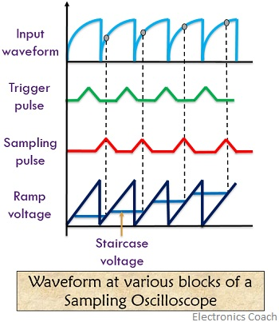
The figure below shows the waveforms at the various blocks of the sampling oscilloscope:

Slide 102
Methods of Sampling
In a sampling oscilloscope, there are various methods by which sampling can be done. The methods are as follows:
Real-time sampling
It is done in order to invade high-frequency samples with accuracy. In this method, the digitizer employed operates at a high speed in order to register most of the points in a single sweep. The high-frequency waveform is so distinct that at any instant the level of current and voltage cannot be correlated with its neighbouring ones.
So, to avoid repetition, it is suggested to register the samples in the time slot of their occurrence. It requires a high-speed memory as the sampling frequency is high.

Slide 103
Equivalent sampling
In this method of sampling, the digitizer operates at samples that are received from the various repetition of the signal. In such a case, each repeated signal can provide one or more samples. This somehow improves the signal invading accuracy.
It is basically done by 2 methods:
Sequential method: In this technique, triggering decides the recording rate of the samples. However, each sample is to be recorded with a little delay. At the time of next triggering, another increment in delay is introduced. The cycle thus repeats in such a manner.
Random sampling method: In this method, triggering does not determine records of the samples instead a clock is employed in the circuit to do so. This means that at regular time interval samples are recorded but that is definitely independent of that of triggering rate.

Slide 104
Advantages
Some of the main advantages of sampling oscilloscopes are:
1. The waveform display is clear.
2. High speed electrical signals can be produced.
3. Very high frequency performance can be achieved.
4. The sampling techniques allow the design of the oscilloscope with wide bandwidth frequency.
Disadvantage of sampling oscilloscope
Sampling oscilloscope allows the measurement to be done on signals having repetitive waveforms.

Slide 105
Fig. 8.14 shows a 50 MHz bandwidth sampling oscilloscope Model TDS2001C manufacture by Tektronix. The model has 16 automated measurements and USB connectivity

Slide 106
STORAGE OSCILLOSCOPE
There are two types of storage oscilloscopes, namely,
1. Analog storage oscilloscope
2. Digital storage oscilloscope

Slide 107
Analog storage oscilloscope
An analog storage oscilloscope uses the phenomenon of secondary electron emission to build up and store electrostatic charges on the surface of an insulated target.
Such oscilloscopes are widely used (i) for real-time observation of events that occur only once, and (ii) for displaying the waveform of a very low frequency (VLF) signal.
The construction of a CRT using variable persistence storage technique, called the halftone or mesh storage CRT is shown in Figure 9.20. With the variable persistence the slow swept trace can be stored on display continuously by adjusting the persistence of the CRT screen to match the sweep time.

Slide 109
Digital Storage Oscilloscope
There are a number of distinct disadvantages of the analog storage oscilloscope. These disadvantages are listed below:
1. There is a finite amount of time that the storage tube can preserve a stored waveform. Eventually, the waveform will be lost. The power to the storage tube must be present as long as the image is to be stored.
2. The trace of a storage tube is, generally, not as fine as a normal cathode ray tube. Thus, the stored trace is not as crisp as a conventional oscilloscope trace.
3. The writing rate of the storage tube is less than a conventional cathode ray tube, which limits the speed of the storage oscilloscope.
4. The storage cathode ray tube is considerably more expensive than a conventional tube and requires additional power supplies.
5. Only one image can be stored. If two traces are to be compared, they must be superimposed on the same screen and displayed together. A superior method if trace storage is the digital storage oscilloscope

Slide 112
What is Digital Storage Oscilloscope?
Definition: The digital storage oscilloscope is an instrument which gives the storage of a digital waveform or the digital copy of the waveform. It allows us to store the signal or the waveform in the digital format, and in the digital memory also it allows us to do the digital signal processing techniques over that signal.
.
It captures non repetitive signals and displays it on the screen until the device gets reset.

Slide 113
In DSO the signals are received, stored and displayed on the screen.
The maximum frequency measured on the digital signal oscilloscope depends upon two things they are:
1) sampling rate of the scope and ADC
2) the nature of the converter. DAC
The traces in DSO are bright, highly defined, and displayed within seconds.

Slide 114
Block Diagram of Digital Storage Oscilloscope
The block diagram of the digital storage oscilloscope consists of an amplifier, digitizer, memory, analyzer circuitry. Waveform reconstruction, vertical plates, horizontal plates, cathode ray tube (CRT), horizontal amplifier, time base circuitry, trigger, and clock. The block diagram of the digital storage oscilloscope is shown in the below figure.
Digital Storage Oscilloscope (DSO)
The digital storage oscilloscope just like a normal oscilloscope is a “test and measurement” equipment.
It makes use of A/D and D/A converters internally to take advantage of processing of signals in digital form. Fig. 8.10 shows the block diagram of a digital storage oscilloscope (DSO).

Slide 115
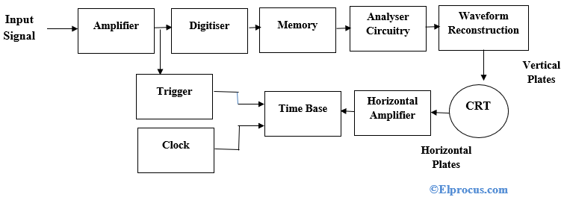

Slide 117
Figure 9.21 gives the block diagram of a digital storage oscilloscope (DSO).
It uses both of digital-to-Analog and Analog-to-Digital (DACs and ADCs) for digitising, storing and displaying analog waveforms. The overall operation is controlled and synchronised by the control circuits.
Which usually have microprocessor executing a control program stored in Read-Only Memory (ROM).
The data acquisition portion of the system contains a sample-and-hold (S/H) and a analog-to-digital converter that repetitively samples and digitized the input signal at a rate determined by the sample clock, and transmits the digitised data to memory for storage.
The control circuit makes sure that successive data points are stored in successive memory locations by continually updating the memory’s address counter.

Slide 118
When memory is full, the next data point from the ADC is stored in the first memory location writing over the old data, and so on for successive data points.
This data acquisition and the storage process continue until the control circuit receives a trigger signal from either the input waveform (internal trigger) or an external trigger source.
When the triggering occurs, the system stops acquiring data further and enters the display mode of operation, in which all or part of the memory data is repetitively displayed on the Cathode Ray Tube (CRT).

Slide 119
Digital Oscilloscope Technology
First the waveforms are conditioned by some analogue circuits then enter in the second stage which involves receiving the digital signals.
To do so, samples have to pass through analogue to digital converter and output signals get recorded in digital memory at different interval of time.
These recorded points together make a waveform. The set of points in a waveform show its length. The rate of samples defines the design of the oscilloscope.
The recorded traces are then processed by the processing circuit and obtained traces are ready to display for visual assessment.

Slide 120
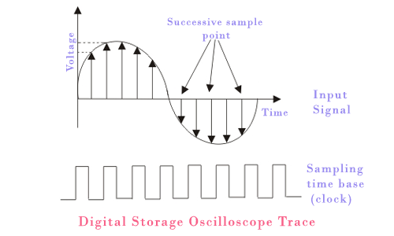

Slide 121
DSO Operation Modes
The digital storage oscilloscope works in three modes of operations they are roll mode, store mode, and hold or save mode.
Roll Mode: In roll mode, very fast varying signals are displayed on the display screen.
Store Mode: In the store mode the signals stores in memory.
Hold or Save Mode: In hold or save mode, some part of the signal will hold for some time and then they will be stored in memory.
These are the three modes of digital storage oscilloscope operation.

Slide 122
Fig. 8.11 shows TDS1000B Series digital storage oscilloscopes. This model has 100 MHz bandwidth.
It provides accurate real-time acquisition up to their full bandwidth. We can easily use USB flash drive to store screenshots and waveform data.
The data can be inserted into your personal computer for importing to desk publishing or spreadsheet programs

Slide 123
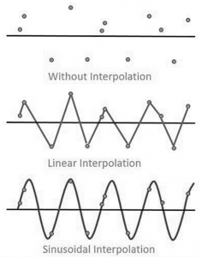
Waveform Reconstruction
There are two types of waveform reconstructions they are linear interpolation and sinusoidal interpolation.
Linear Interpolation: In linear interpolation, the dots are joined by a straight line.
Sinusoidal Interpolation: In sinusoidal interpolation, the dots are joined by a sine wave.
Waveform Reconstruction of Digital Storage Oscilloscope

Slide 124
Advantages
The digital storage oscilloscope(DSO) has many advantages than that of normal oscilloscope.
Some of the advantages are as listed below:
1. Since the DSO uses digital memory, it can store the waveforms for longer time. But in the normal CRO this cannot happen.
2. In the DSO, we can store and view the part or full waveforms before the actual trigger happens. But this is not possible in the conventional CRO.
3. In the DSO, the stored waveform can be positioned anywhere in the screen. We can actually adjust the vertical and horizontal scales of the waveform. This is not possible in the normal CRO.
4. Nowadays most of the DSOs can store as many waveforms in the memory and if needed we can take the printouts of the waveforms by connecting a normal standard printer to the DSO.

Slide 125
Disadvantages
The digital storage oscilloscope (DSO) has the following disadvantages:
1. DSOs are costly as compared to other oscilloscopes.
2. Slower compared to conventional oscilloscopes.

Slide 126
8.10 Applications of DSO
Following are some of the important applications of a DSO, which are important from the subject point of view:
1. Observation of single-pulse events: There are many phenomena which occur only once.
Like occurrence of spike in any signal in a time due to some external effects, is only for the small instant of time. This can be easily recorded in the storage oscilloscope and analyzed when it required.
2. Observation of portion of waveform: The waveform recorded by storage oscilloscope is analyzed with greater detail.
3. Enlargement of waveform: Very small variation in the amplitude and frequency of the waveform is analyzed with this oscilloscope.
4. Mathematical operations: Waveform addition, subtraction, multiplication, integration, differentiation and feature comparison are possible with DSO.
5. As a measuring device: It can be used as multimeter, voltmeter, ammeter, ohmmeter, temperature meter etc

Slide 127
It checks faulty components in circuits
Used in the medical field
Used to measure capacitor, inductance, time interval between signals, frequency and time period
Used to observe transistors and diodes V-I characteristics
Used to analyze TV waveforms
Used in video and audio recording equipment’s
Used in designing
Used in the research field
For comparison purpose, it displays 3D figure or multiple waveforms
It is widely used an oscilloscope

Slide 128
8.11 Acquisition Methods
In digital storage oscilloscope it is necessary to capture the digital signal and store it. There are
three different types of acquisition methods.
1. Real time sampling. In this method the response to single trigger event, a complete record of N samples, is simultaneously captured on each channel. From these samples recorded in a single acquisition cycle, the waveform is displayed on the screen of digital storage oscilloscope.
2. Random repetitive sampling. In this method repeated real time data acquisition cycles are performed. Each sample value is plotted independently on display as a dot. Interpolation between samples is not done. Each acquisition cycle produces random time interval between trigger point and sample clock.
3. Sequential repetitive sampling. In this method one sample per trigger event is captured at a carefully controlled time delay after the triggering pulses. This delay is increased by small amount after each point is captured. The single sample acquisition cycle is repeated till the entire waveform has been plotted.

Slide 129
Difference Between Digital Storage Oscilloscope and Conventional Storage Oscilloscope
The difference between DSO and the conventional storage oscilloscope or analog storage oscilloscope (ASO) is shown in the below table.

